Slide 1
CS 2212
Introduction to Software Engineering
Chapter 15 Quality Concepts

Slide 2
Copyright Notice This Presentation and Its Associated Video Contain Copyright Material. This Presentation and Its Associated Video Are Provided for Teaching Purposes of CS2212 and Should Not Be Posted In Any External Site, Or Shared with. This Presentation and Its Associated Video Are Provided For Instructional Personal Use Only, and Only For The Purposes of the CS2212 Course.

Slide 3
Part 42
Software Quality Concepts
When to use iterative development? You should use iterative development only on projects that you want to succeed.
― Martin Fowler.
Notes:
This lesson introduces the basic steps in a software engineering project at a high level.
In practice, steps often overlap.

Slide 4
Learning Objectives in this Module
To understand the concept and dimensions of software quality
To understand the impact quality or the lack of quality has on a software system

Slide 5
Quality
Are quality of design and quality of conformance the only issues that software engineers must consider?
Quality is important, but if the user isn’t satisfied, does that matter?
Perhaps, a more “intuitive” relationship is in order:
User satisfaction = compliant product + good quality + delivery within budget and schedule

Slide 6
Quality—Various Views
The transcendental view argues (like Persig) that quality is something that you immediately recognize, but cannot explicitly define
The user view sees quality in terms of an end-user’s specific goals; if a product meets those goals, it exhibits quality
The manufacturer’s view defines quality in terms of the original specification of the product; if the product conforms to the spec, it exhibits quality

Slide 7
Quality—Various Views
The product view suggests that quality can be tied to inherent characteristics (e.g., functions and features) of a product
Finally, the value-based view measures quality based on how much a customer is willing to pay for a product
Ultimately, in reality, quality encompasses all of these views and more …

Slide 8
Software Quality
Even the most jaded software developers will agree that high-quality software is an important goal
How do we define software quality though? In the context of software engineering, software quality refers to two related but distinct notions [1]:
“Software functional quality reflects how well it complies with or conforms to a given design, based on functional requirements or specifications. It is the degree to which the correct software was produced”.[1]
“Software structural quality refers to how it meets non-functional requirements that support the delivery of the functional requirements, such as robustness or maintainability. It has a lot more to do with the degree to which the software works as needed”.[1]
[1] https://en.wikipedia.org/wiki/Software_quality

Slide 9
Software Quality – Effective Software Process
An effective software process establishes the infrastructure that supports any effort at building a high quality software product
The management aspects of process create the checks and balances that help avoid project chaos—a key contributor to poor quality
Software engineering practices allow the developer to analyze the problem and design a solid solution—both critical to building high quality software
Finally, umbrella activities such as change management and technical reviews have as much to do with quality as any other part of software engineering practice

Slide 10
Software Quality – Useful Product
A useful product delivers the content, functions, and features that the end-user desires
Just as important, it delivers these assets in a reliable, error free way
A useful product always satisfies those requirements that have been explicitly stated by stakeholders
In addition, it satisfies a set of implicit requirements (e.g., ease of use) that are expected of all high quality software

Slide 11
Software Quality – Adding Value
By adding value for both the producer and user of a software product, high quality software provides benefits for the software organization and the end-user community
The software organization gains added value because high quality software requires less maintenance effort, fewer bug fixes, and reduced customer support
The user community gains added value because the application provides a useful capability in a way that expedites some business process

Slide 12
Garvin’s Quality Dimensions
Performance Quality. Does the software deliver all content, functions, and features that are specified as part of the requirements model in a way that provides value to the end-user?
Feature quality. Does the software provide features that surprise and delight first-time end-users?
Reliability. Does the software deliver all features and capability without failure? Is it available when it is needed? Does it deliver functionality that is error free?

Slide 13
Garvin’s Quality Dimensions
Conformance. Does the software conform to local and external software standards that are relevant to the application? Does it conform to de facto design and coding conventions? For example, does the user interface conform to accepted design rules for menu selection or data input?
Durability. Can the software be maintained (changed) or corrected (debugged) without the inadvertent generation of unintended side effects? Will changes cause the error rate or reliability to degrade with time?

Slide 14
Garvin’s Quality Dimensions
Serviceability. Can the software be maintained (changed) or corrected (debugged) in an acceptably short time period? Can support staff acquire all information they need to make changes or correct defects?
Aesthetics. Most of us would agree that an aesthetic entity has a certain elegance, a unique flow, and an obvious “presence” that are hard to quantify but evident nonetheless.
Perception. In some situations, you may have a set of prejudices that influences your perception of quality, leading you to find faults where there are none, or to see quality where it is lacking.

Slide 15
McCall’s Quality Factors
McCall, Richards, and Walters proposed a useful categorization of factors that affect software quality
These software quality factors focus on three important aspects of a software product:
Its operational characteristics
Its ability to undergo change or revision
Its adaptability and ability to transition to new environments

Slide 16
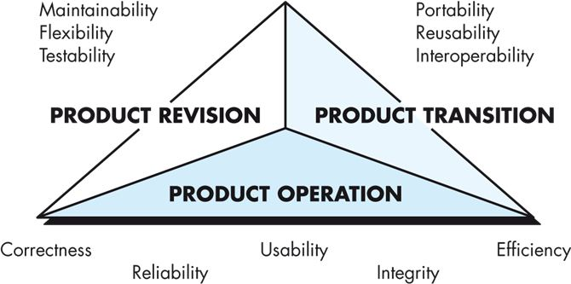
McCall’s Quality Factors

Slide 17
McCall’s Quality Factors
Correctness: The extent to which a program satisfies its specification and fulfills the customer’s mission objectives.
Reliability: The extent to which a program can be expected to perform its intended function with the required precision.
Efficiency: The amount of computing resources and code required by a program to perform its function.
Integrity: The extent to which access to software or data by unauthorized persons can be controlled.

Slide 18
McCall’s Quality Factors
Usability: The effort required to learn, operate, prepare input for, and interpret output of a program.
Maintainability: The effort required to locate and fix an error in a program. (Note that McCall’s definition here is a somewhat limited one.)
Flexibility. The effort required to modify an operational program.
Testability: The effort required to test a program to ensure that it perform its intended function.

Slide 19
McCall’s Quality Factors
Portability: The effort required to transfer the program from one hardware and/or software system environment to another.
Reusability: The extent to which a program (or parts of a program) can be reused in other applications – related to the packaging and scope of the functions that the program performs.
Interoperability: The effort required to couple one system to another.

Slide 20
ISO 9126 Quality Factors
The ISO 9126 standard was developed in an attempt to determine the key quality attributes for computer software, identifying six key attributes:
Functionality. The degree to which the software satisfies stated needs as indicated by the following sub-attributes: suitability, accuracy, interoperability, compliance, and security.
Reliability. The amount of time that the software is available for use as indicated by the following sub-attributes: maturity, fault tolerance, recoverability.
Usability. The degree to which the software is easy to use as indicated by the following sub-attributes: understandability, learnability, operability.

Slide 21
ISO 9126 Quality Factors
Efficiency. The degree to which the software makes optimal use of system resources as indicated by the following subattributes: time behaviour, resource behaviour.
Maintainability. The ease with which repair may be made to the software as indicated by the following subattributes: analyzability, changeability, stability, testability.
Portability. The ease with which the software can be transposed from one environment to another as indicated by the following subattributes: adaptability, installability, conformance, replaceability.

Slide 22
The Transition to a Quantitative View
General quality dimensions and factors are not adequate enough for assessing the quality of an application in concrete terms
Project teams need to develop a set of targeted questions to assess the degree to which each application quality factor has been satisfied
Subjective measures of software quality may be viewed as little more than personal opinion
Software metrics represent indirect measures of some manifestation of quality and attempt to quantify the assessment of software quality

Slide 23
The Cost of Quality
Delivering quality software has a cost, in terms of time and money
It is important to remember, however, that a lack of quality also has a cost, not only to end users who must live with buggy software, but also to the software organization that has built and must maintain it
The cost of quality can be divided into costs associated with prevention, appraisal, and failure

Slide 24
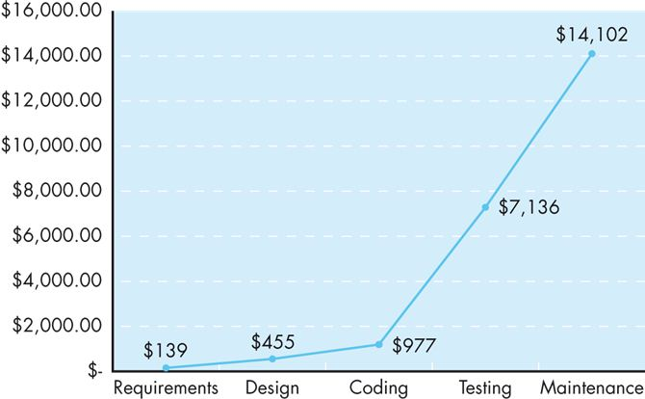
The Cost of Quality
The relative costs to find and repair an error or defect increase dramatically as we go from prevention to appraisal to internal failure to external failure costs
This chart reflects real world data collected by Boehm and Basili, and illustrated by Cigital Inc.

Slide 25
Quality and Risk
Example:
Throughout the month of November, 2000 at a hospital in Panama, 28 patients received massive overdoses of gamma rays during treatment for a variety of cancers. In the months that followed, five of these patients died from radiation poisoning and 15 others developed serious complications. What caused this tragedy? A software package, developed by a U.S. company, was modified by hospital technicians to compute modified doses of radiation for each patient.
The three Panamanian medical physicists who tweaked the software to provide additional capability were charged with second degree murder.
The U.S. company was faced with serious litigation in two countries.

Slide 26
Negligence and Liability
The story is all too common: A governmental or corporate entity hires a major software developer or consulting company to analyze requirements and then design and construct a software-based “system” to support some major activity.
The system might support a major corporate function (e.g., pension management) or some governmental function (e.g., healthcare administration or homeland security).
Work begins with the best of intentions on both sides, but by the time the system is delivered, things have gone bad.

Slide 27
Negligence and Liability
The system is late, fails to deliver desired features and functions, is error-prone, and does not meet with customer approval. Litigation ensues.
In most cases, the customer claims that the developer has been negligent in the manner in which it has applied software practices and is not entitled to payment.
The developer often claims that the customer has repeatedly changed its requirements and has subverted the development partnership in other ways.
In every case, the quality of the delivered system comes into question.

Slide 28
Achieving Software Quality
Software quality doesn’t just appear
Software quality is the result of good project management and solid engineering practice
This comes into play in four broad activities:
Software engineering methods
Project management techniques
Quality control
Quality assurance

Slide 29
Your Turn
Select four key quality characteristics of software systems and discuss their importance in practical applications. What would be the repercussions if these qualities are not present.
Assuming a software project where the requirements constantly change while the delivery time and budget remain the same. What is the anticipated impact on the quality of the system being built?
Assume a software system which calculates the specifications (strength, dimensions etc.) of steel beams to be used for building bridges. The system provides correct calculations for bridges of span less than 100m long and which are used only for pedestrian traffic. The software system does not include any warnings that the system will not produce correct calculations if a user exceeds these limitations (i.e. the 100m span limit, only pedestrian traffic). A civil engineer is using the system to calculate the steel beams for a bridge which is 120m long and bearing light motor traffic. The bridge collapses. Who do you think is negligent? The civil engineer for using the system, the software engineer for not including warnings, both? Provide your opinion, and explain your answer.

Slide 30
Your Turn
Check out the content of the following sites:
https://en.wikipedia.org/wiki/Software_quality
https://asq.org/quality-resources/software-quality
https://www.quora.com/What-is-software-quality
https://en.wikipedia.org/wiki/ISO/IEC_9126
http://profs.etsmtl.ca/wsuryn/research/SQE-Publ/SQuaRE-second%20generation%20of%20standards%20for%20SW%20Quality%20%28IASTED03%29.pdf (copy/paste the link)
https://en.wikipedia.org/wiki/Continuous_delivery
https://saucelabs.com/blog/shift-left-continuous-testing-eliminating-risk-through-agile-testing-practices

